Slide 1

Test Case Generations

Slide 2
Overview
New Changes Introduced
Comparison Report

Slide 3
Improved the .md files creation
Now all .md files are being created in same format.
Formatting was made consistent using a sample .md file created manually and then passing it to the prompt

Slide 4
Vector Database Storage
Vector database is being saved in ChromaDB
It is being saved in systematic folder structure

Slide 5
Initial Test case generation
Changed the prompt so that results being generated are of better quality.

Slide 6
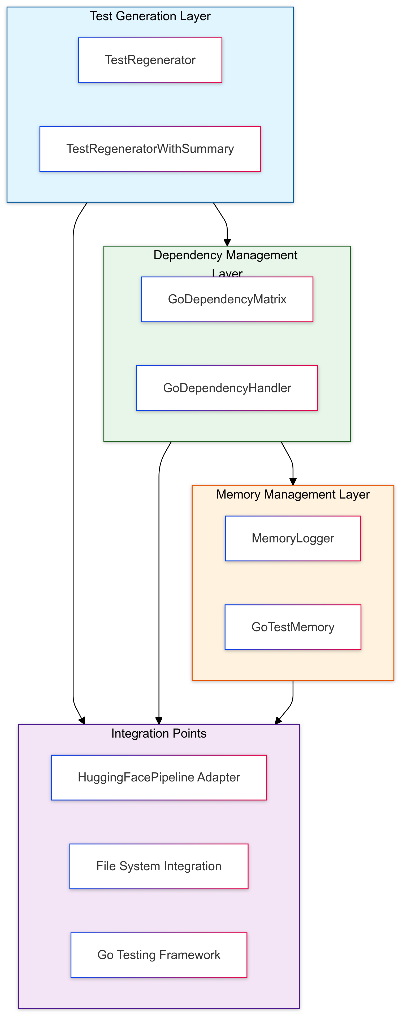
System Architecture Overview : Debugger
Core Architecture
Three-Layer Architecture:
1. Test Generation Layer (TestRegenerator, TestRegeneratorWithSummary)
2. Dependency Management Layer (GoDependencyMatrix, GoDependencyHandler)
3. Memory Management Layer (MemoryLogger, GoTestMemory)
Integration Points
LLM Integration via HuggingFacePipelineAdapter
File System Integration for Test Management
Go Testing Framework Integration

Slide 7
Component Details
TestRegenerator Components
TestRegenerator: - regenerate_and_validate() - run_go_test() - analyze_errors()
Enhanced Components
TestRegeneratorWithSummary: - Summary-based memory - Pattern recognition - Context optimization
Supporting Systems
Logging and Monitoring Infrastructure
Error Analysis Framework
Memory Management Systems

Slide 8
2.1: Test Generation Workflow
Generation Pipeline
1. Source Code Analysis
2. Dependency Resolution
3. Test Template Generation
4. LLM-based Enhancement
Error Handling
Automatic Error Detection
Pattern-based Error Resolution
Iterative Improvement Process

Slide 9
Advanced Generation Features
Intelligent Test Generation
Context-Aware Test Cases
Pattern Recognition from Previous Success
Adaptive Learning System
Key Algorithms:
1. Error Pattern Analysis 2. Test Case Generation 3. Validation Pipeline 4. Coverage Optimization

Slide 10
3.1: Dependency Analysis System
Matrix-Based Analysis
Adjacency Matrix for Dependencies
Transitive Closure Computation
Cycle Detection Algorithm
Example Matrix Structure:
[0 1 0] File A [0 0 1] File B [1 0 0] File C

Slide 11
Advanced Dependency Features
Dependency Resolution
Circular Dependency Handling
Import Graph Analysis
Function Call Tracking
Optimization Features
Minimal Build Set Determination
Parallel Test Execution Planning
Incremental Build Strategy

Slide 12
Memory Systems Architecture
Memory Types
Conversation Buffer Memory
- Full interaction history - Detailed context tracking - Pattern extraction
Summary Memory
- Condensed context - Key pattern storage - Optimized retrieval

Slide 13
Performance Analysis System
Metrics Tracking
Success Rate Analysis
Memory Usage Optimization
Generation Speed Metrics
Comparative Analysis
Key Performance Indicators:
Test Coverage Percentage
Generation Time per Test
Memory Efficiency Ratio
Error Resolution Rate

Slide 14
